Slide 1
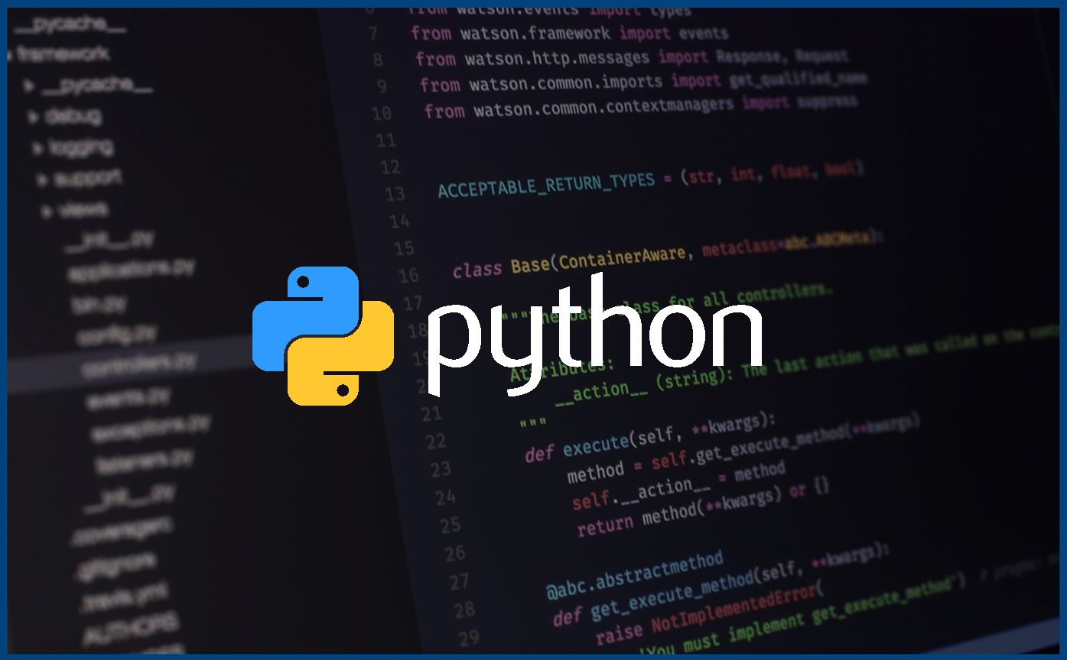
Introduction to Python!

Slide 2
Review from last week
type(some_variable) returns the type of that variable
We have to make sure that our code is indented properly
Something I missed: the keyword len returns the length of a string
Example: len(“water”)
This would be 5
The pass keyword is an empty statement

Slide 3
1.
More about loops!

Slide 4
While Loop Review
Loop runs the code within the “scope” of the while loop, while the condition is true
Our condition has to evaluate to true or false
Code which we want to run inside the while loop should be indented as to be inside the loop

Slide 5
Boolean Conditions
Conditions that either evaluate to true or false
We need these to check “if” or do “while” some condition is either true or false
The most common ones are:
> greater than (>=)
< less than (>=)
== True
== False

Slide 6
Iterables

Slide 7
Iterable Objects
Iterables are containers that can store multiple values and are capable of returning them one by one.
Iterables can store any number of values. In Python, the values can either be the same type or different types.

Slide 8
For Loops
Last week we saw that a for loop can loop code “for” each value in a range of numbers
for value in range(10):
range(10) creates an iterable (0-9)
The for loop then runs one time for each value in the iterable object
We can extend this functionality to any python object that is iterable
String
List
Syntax: for value in iterable

Slide 9
Lists
We use lists to store multiple items in a single variable
Lists are one of Python’s built in methods of storing collections of data
Syntax: my_list =[] # use square brackets
Lists are known as “ordered” because they have a defined order
list[0] # first item
list[1] #second item
…
We can get the amount of items in a list (length) by using the len() method: len(my_list)

Slide 10
List Indexing and Methods
Indexing a list works the same way that we saw with strings
[0] gets the first element
[1] gets the second
We have negative indexing still [-1] is the last, [-2] is second last
We can still slice them too, [1:-2] gives the second to second last items
[:3] gives element 0 to 2
Important list methods:
https://www.w3schools.com/python/python_ref_list.asp
append(item)
clear()
count(item)
extend(iterable)
index(item)
insert(index, item)
remove(item)
reverse()

Slide 11
List Comprehension
List Comprehension gives us a nicer, shorter syntax when we want to make a list
https://www.w3schools.com/python/python_lists_comprehension.asp
Create a list for each item in an iterable, which can be filtered by boolean conditions
We use list brackets around the condition and the in keyword to iterate over an iterable
syntax : my_list = [x for x in range(10) if x%2 != 0]
My_list = [y if y > 5 else 0 for y in range(10)]

Slide 12
Lists and Loops

Slide 13
Iterating over a list
What does this code do?
my_list = [1, 2, “hello”, True, 10, “11”, 3]
for item in my_list:
print(item)

Slide 14
Exercise 1 Lists:
Let’s write a program which multiplies each value in a list together
Count even and odd numbers in a list
Swap first and last element of a list

Slide 15
Exercise 2:
Let’s write a program which:
Takes in a range of (positive) numbers from the user.
Creates a list for each number in that range
Does the above until the sum of our range is even and greater than 256

Slide 16
Exercise 3:
Let’s write a program which:
Adds user input into a list until “stop is typed”
Then counts the different types of variables in the list
And tells the user how many of each type there are

